Slide 1
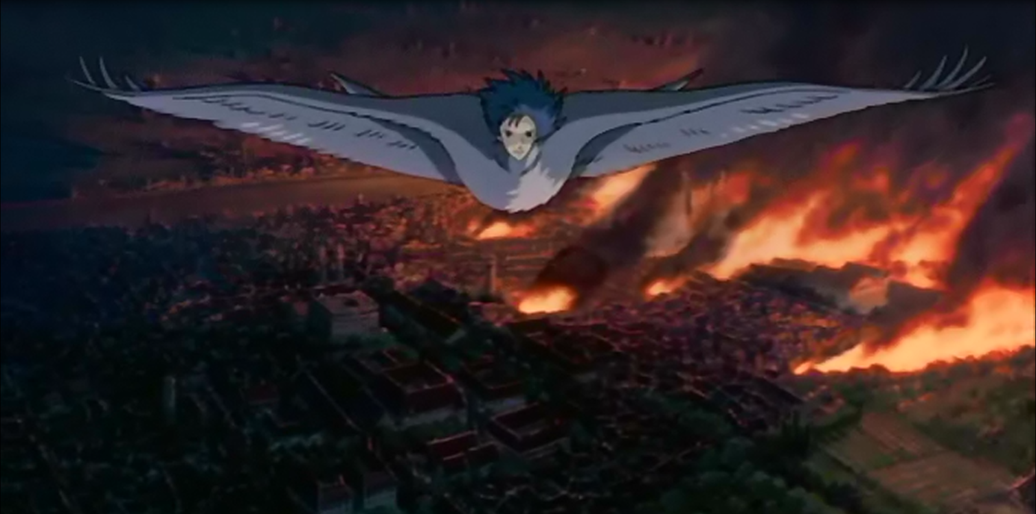
Howl’s Moving Castle
Mise-en-scene
By Jamie Wheeler
Max Morrison
Chance McDougall

Slide 2
Table of Contents
War In Howl’s Moving Castle
Introduction
The impact of language and structural choices on shaping own and others interpretations.
Symbolism
The ways ideas, attitudes and voices are represented.
The interplay between imaginative, interpretive and representative techniques.
Analysing changing responses to texts over time and in different cultural contexts
How anime film as a different text type shapes audience responses.

Slide 3
War in Howl’s Moving Castle
War is a common theme in Howl’s Moving Castle, as the movie was created because of Hayao Miyazaki’s outrage and disgust for the 2003 Iraq War. War is portrayed in the film through both Howl’s eyes as a destructive resolve to disputes and the kingdoms eyes, through the street parades, as a means to a better life and something that is good for their nation. Throughout the film we are shown the things Howl sees and are persuaded to feel for Howl and his way of seeing the war.

Slide 4
Introduction
War has occurred throughout history as a way of settling disputes between one or multiple nations; it has caused huge loss and suffering to the people. War in the mise-en-scene is portrayed as a destructive force that tears apart relations and destroys peace. Howl’s Moving Castle, by Hayao Miyazaki, is a fantasy fiction film developed in 2004. The definition of war is a state of armed conflict between different countries or different groups within a country. Howl’s Moving Castle tells the tale of Sophie Hatter, a young girl living Ingary, she becomes cursed into an elderly age and proceeds on a quest to amend the spell. The film was made because of Miyazaki’s outrage and disgust for the 2003 Iraq War. Howl’s Moving Castle can quite closely be related to ‘My Hiroshima’, by Junko Morimoto, as both cover the topic of war and the impact it has on life in the afflicted countries. The viewers of the mise-en-scene are positioned to feel negatively to war crimes. Howl’s Moving Castle is a dominant reading as it has common themes and problems that exist in today’s society. The viewer of the mise-en-scene is made to feel negatively towards war crimes by the use of technical codes, symbolism and setting

Slide 5
The impact of language and structural choices on shaping own and others interpretations.
‘This war is terrible, they bomb from the southern coast to the northern border. It’s all in flames now.’ -Howl
This quote outlines the seriousness of war and its increasing damage. Not only does war destroy peoples lifes, but also destroys nature and implicates industrial advancements as harmless to the environment.
‘Let’s finally put an end to this foolish war.’-Sophie
This quote by Sophie implies that war is an unnecessary means, to which it can only be resolved through agreeance rather than more violence.

Slide 6
‘After the war they won’t recall they were ever human.’-Howl
This quote by howl, relates to the real life consequence of war and its effects on the parties involved. It suggests After having committed war crimes, that the soldiers involved will not be able to come back mentally and in term would be seen as monsters for taking part in such violence. It implies that war is unhuman and destructive, it can only lead to death and the corruption of innocence.
‘Let’s run away! There’s no use fighting.’-Sophie
This quote by Sophie relates to the anti-war ideas in the way that it is suggested that the act of war should not make one act in a different and selfish way. Its easier running from such violence rather than participating in it and only provoking a game of tug-of- war in which a battle between two enemies would continue back and forth.

Slide 7
Symbolism
The mise-en-scene from the animation film ‘howls moving castle’ by Hayao Mayizaki symbolises many ideas through the use of colour, expression and juxtaposing.
Colour: In this particular image, Howl has become a black bird and has found himself flying over lands covered in colours of red and dark shades. Black birds are symbolic of death and in some cases pure potential, however, in Japan the Black bird or in most familiar form, crow, symbolised life and in many ancient beliefs people seem to worship the black bird to which an ancient god by the name of The Crow Tengu descended from. The Tengu is believed to be half human and half crow which follows the description of Howl in many ways. In this still image, howls hair is also gold/blonde which symbolises wealth, power and Royality. The red in the background symbolises murder and greed through violence in which it collects the idea of war.

Slide 8
Expression: Howls facial expression suggests that he is not happy and rather disappointed in the result of the war and the vass damage it has caused. His eyes are squinted into an angry frown which further supports this idea. He is also gazing off into the distance rather than looking back at the war, Suggesting that he wishes to look into the future for a resolution rather than reflect on the math of the battle.
Juxtaposition: the elements of this image work together to symbolise the significance of war and the potential of hope through power and royalty to which Howl possesses. It also foreshadows moving past the war and not looking back, it could even imply that Howl is above the war and able to stop it using his powers.

Slide 9
The ways ideas, attitudes and voices are represented.
Ideas (War): War is represented in the mise-en-scene through the destruction of the city. As it burns the wars influence on the land and the people is devastating and causes mass suffering to these elements.
Attitude (War is not the solution): The attitude that war is not the solution is represented through Howl flying away from the burning city being rained down on by a bombardment of explosives.
Voices (Upset, filled with angst): Voices are represented as upset and angst filled by the mise-en-scene through its use of dark colours which lead the reader to feel this exact thing.

Slide 10
The interplay between imaginative, interpretive and representative techniques.
The scene shows a fantasy/imaginative world in which war is shown as a destructive force. Through this use of an imaginative world Hayao Miyazaki is able to convey the destructiveness of war without causing distress of to realistic of an event to the viewer.
The war is interpreted in two different ways: as good and as evil. Through Howl’s view the war is an evil force, that isn’t helping anything and is just causing more problems than it will solve. Through the King’s and Kingdom’s view the war is a good thing that will solve all their problems and give them a greater way of life.
Through the use of colours, mainly black, dark greys and red the idea of war is represented as violent, sad, evil and full of anger.

Slide 11
Analysing changing responses to texts over time and in different cultural contexts
The response to this text was influenced by what audience it was displayed to. Displayed to the American population, though thought to be received negatively in the U.S., it was actually received very well. It should have, according to Miyazaki, have been received in the U.S. with outrage due to it being his take on the 2003 Iraq War that the U.S. were involved in at the time of production. This response that should have occurred was changed due to the American population agreeing with the idea of the film.

Slide 12
How anime film as a different text type shapes audience responses.
Anime film shapes audience responses being a different text type by portraying everything as more innocent and delicate than in the actual world as opposed to the fantasy world.
This use of anime film helps to shape audience responses as opposed to realistic films with human actors. As Hayao Miyazaki was able to create a world in which he could express his view and cause a sense of upset and angst in the audience without causing severe distress to too realistic of a scenario.

